Slide 1


Telecom Churn Analysis
Analyzing Telecom Churn Data for Business Insights and Predictive Modeling
FINAL PROJECT - 02

Slide 2

OBJECTIVE
Uncover key business insights through exploratory data analysis (EDA).
Understand customer churn patterns.
Develop a classification model to predict customer churn.

Slide 3
KEY ANALYSIS
Impact of international and voice mail plans on churn rates.
Relationship between customer service calls and churn.
Comparison of usage patterns between churned and non-churned customers

Slide 4
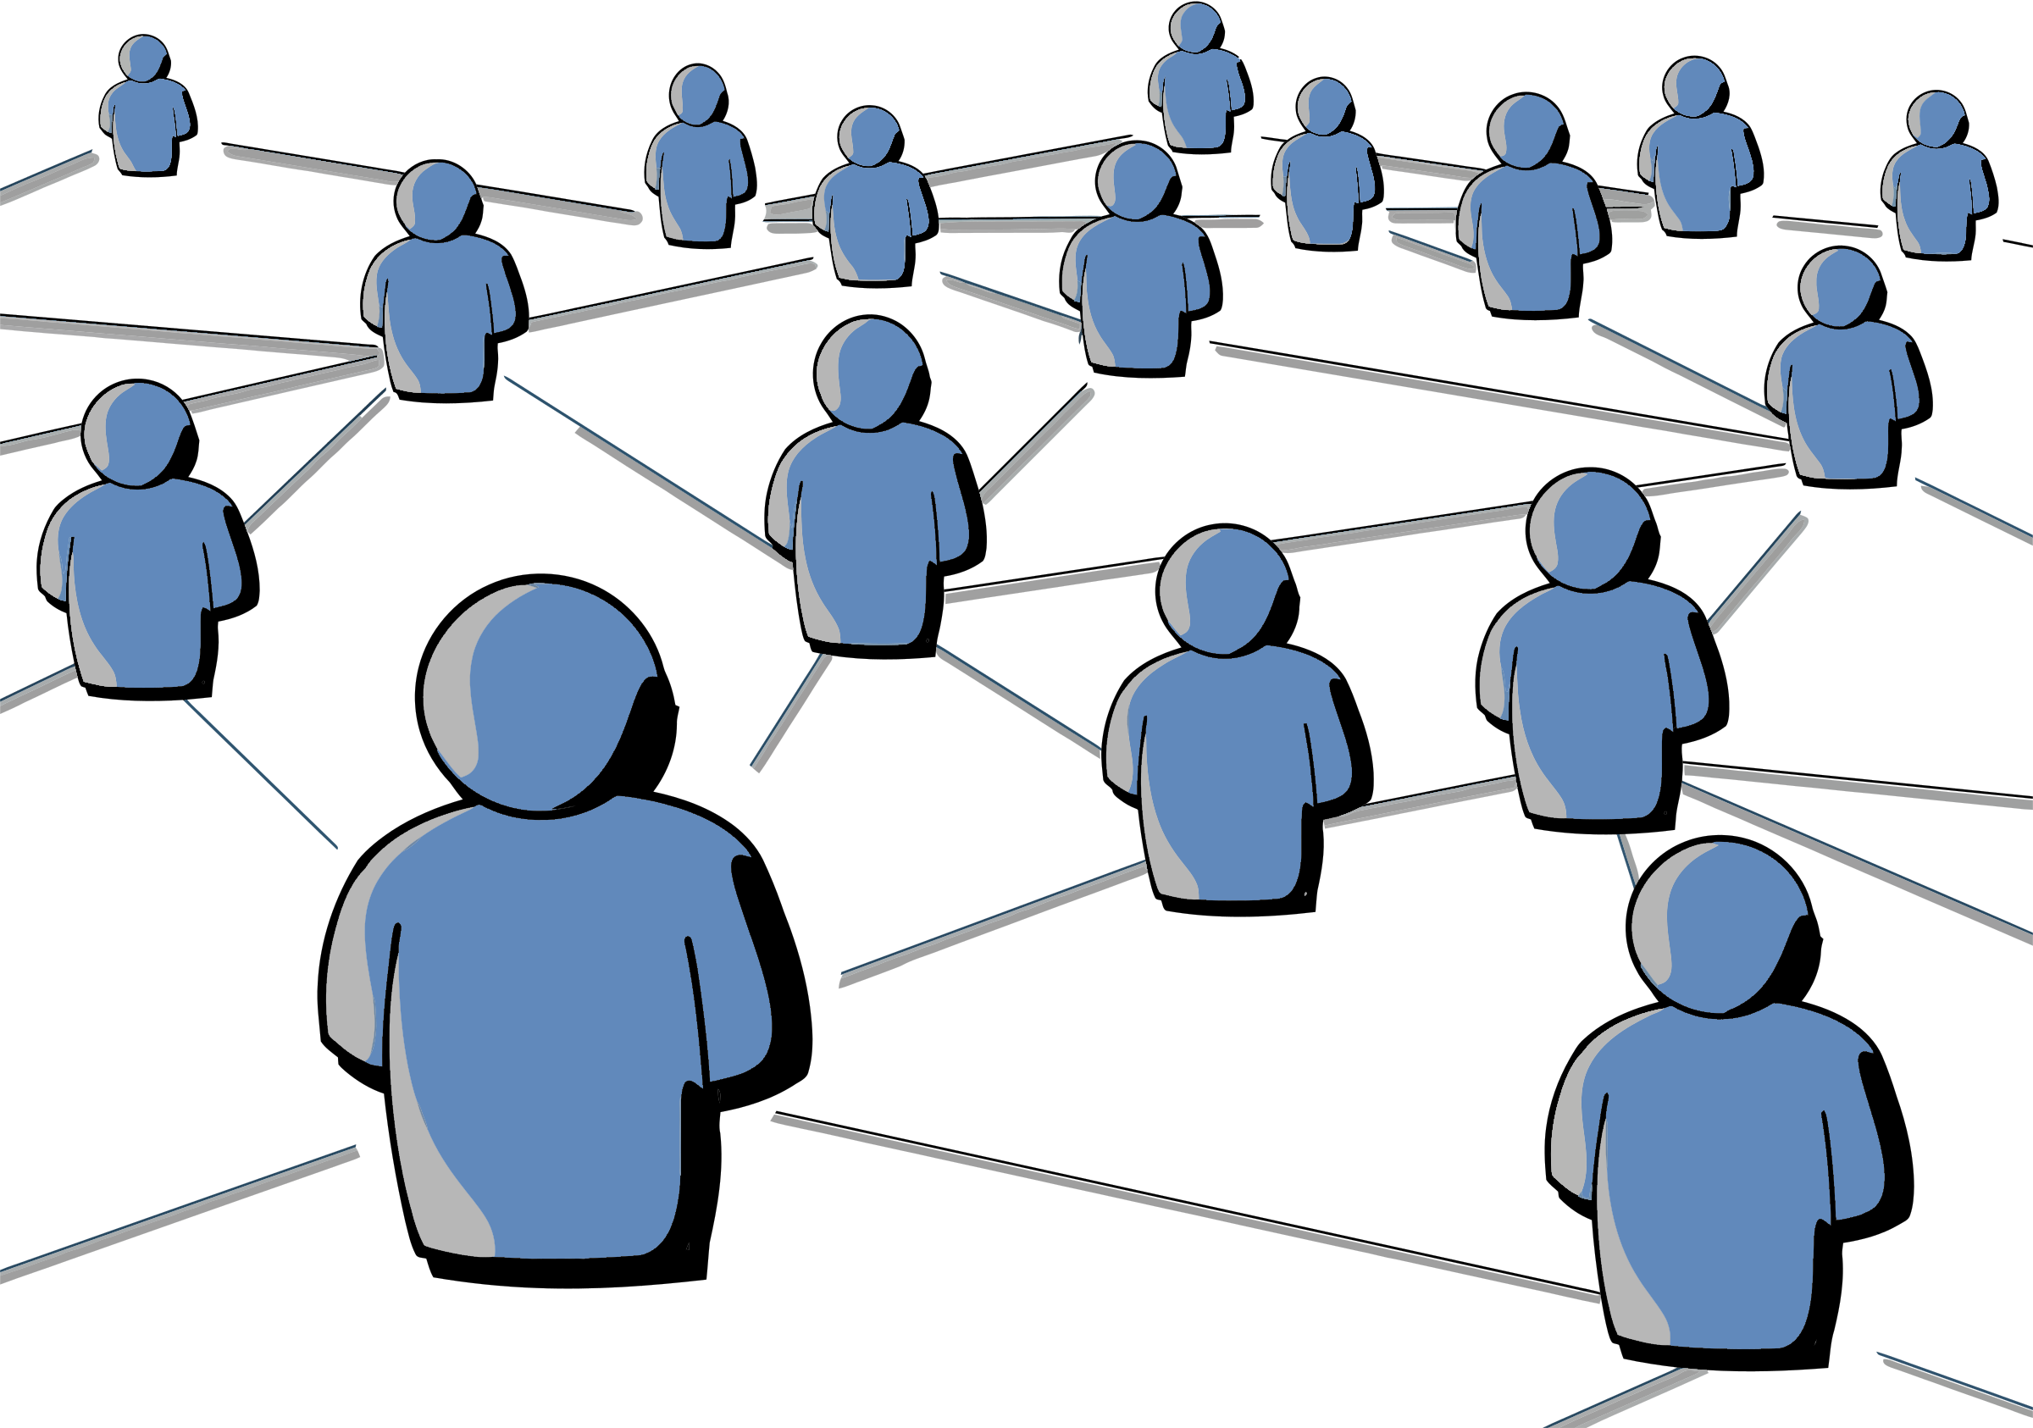
DATA ANALYSIS

Slide 5
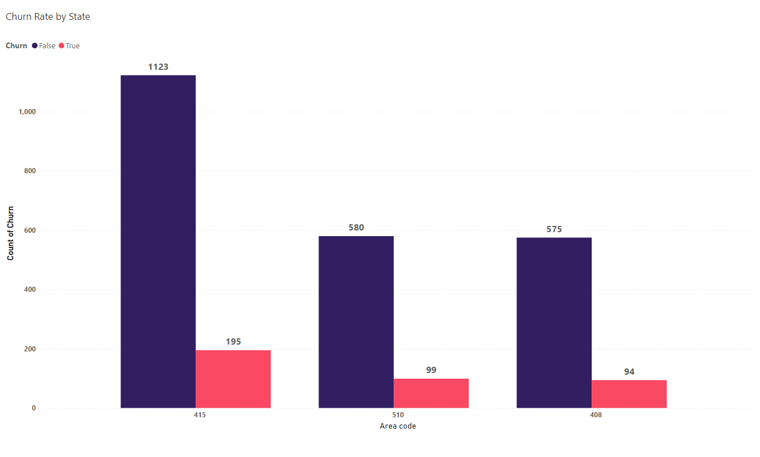

Slide 6

Churn rate by State
INSIGHTS
RECOMMENDATIONS
Churn is present in all three regions, averaging 14%
Even churn distribution suggests a common issue is causing customer churn
States with fewer customer complaints might show lower churn rates
Improve customer service in high-churn states to enhance satisfaction
Offer targeted promotions in regions with high churn rates
Analyze feedback to address specific issues leading to churn in these states

Slide 7
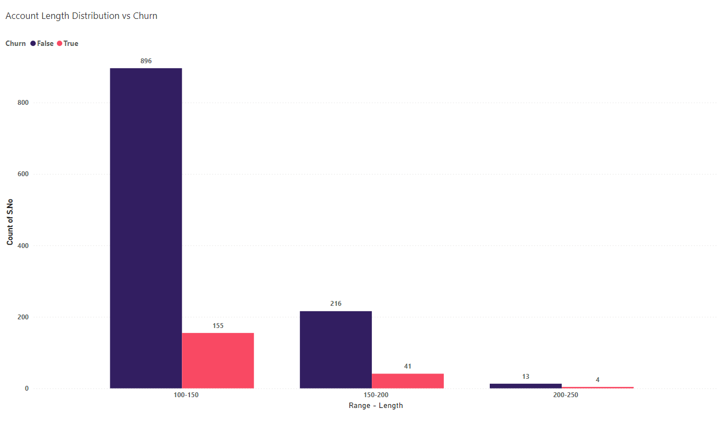

Slide 8
Account Length Distribution vs Churn
INSIGHTS
RECOMMENDATIONS
Customers with shorter account lengths (less than 150 days) are more likely to churn.
Customers with longer tenures (over 200 days) have a lower churn rate
Account length appears to be a good indicator of customer churn
Focus efforts on retaining new customers (under 150 days) with special offers
Proactive engagement with new customers can improve satisfaction and reduce churn.
Develop loyalty programs or benefits to incentivize long-term customers

Slide 9
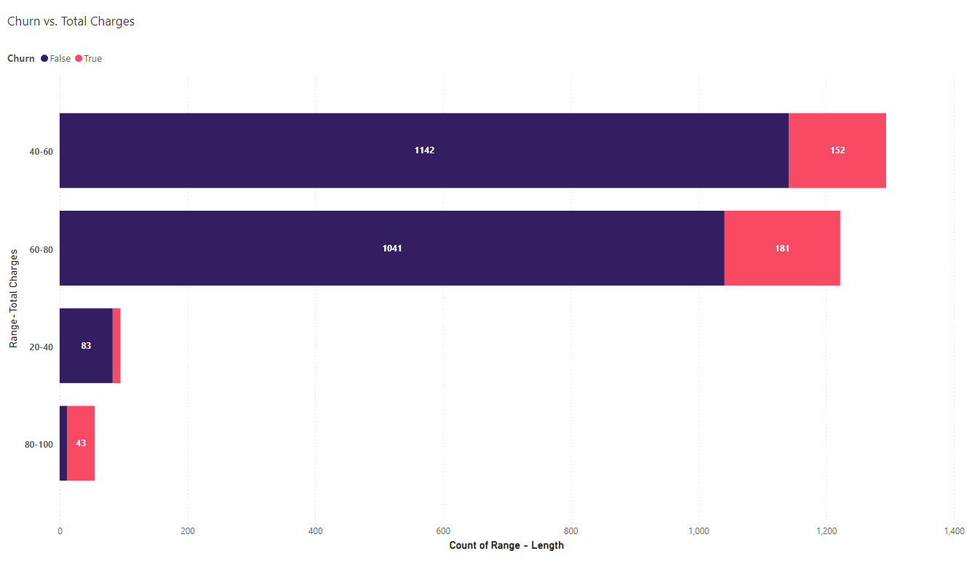

Slide 10
Churn vs. Total Charges
INSIGHTS
RECOMMENDATIONS
Customers with higher total charges churn at a higher rate
Customers spending less tend to churn less frequently
Total charges appear to be a good correlator of customer churn
Reduce churn by providing competitive rates to retain price sensitive customers
Offer attractive bundled services to high-value customers to improve loyalty
Track customer usage patterns and recommend suitable plans to reduce churn

Slide 11
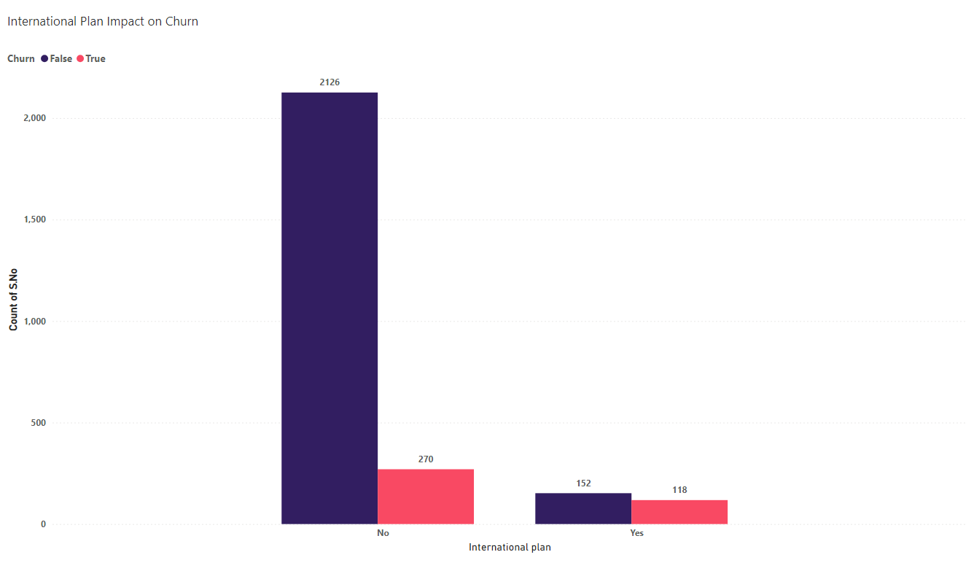

Slide 12
International Plan Impact on Churn
INSIGHTS
RECOMMENDATIONS
Customers with international plans have a higher churn rate
The problem might be due to Higher Costs, Issues with call Quality/Connectivity or plans may lack features or benefits that customers expects
International plan uptake is low, with a high dissatisfaction rate
Launch periodic promotions for international plan users to encourage retention
invest in network improvements to enhance call quality and cater to diverse customer needs
Regularly gather feedback from international plan users to understand their needs and address issues proactively

Slide 13
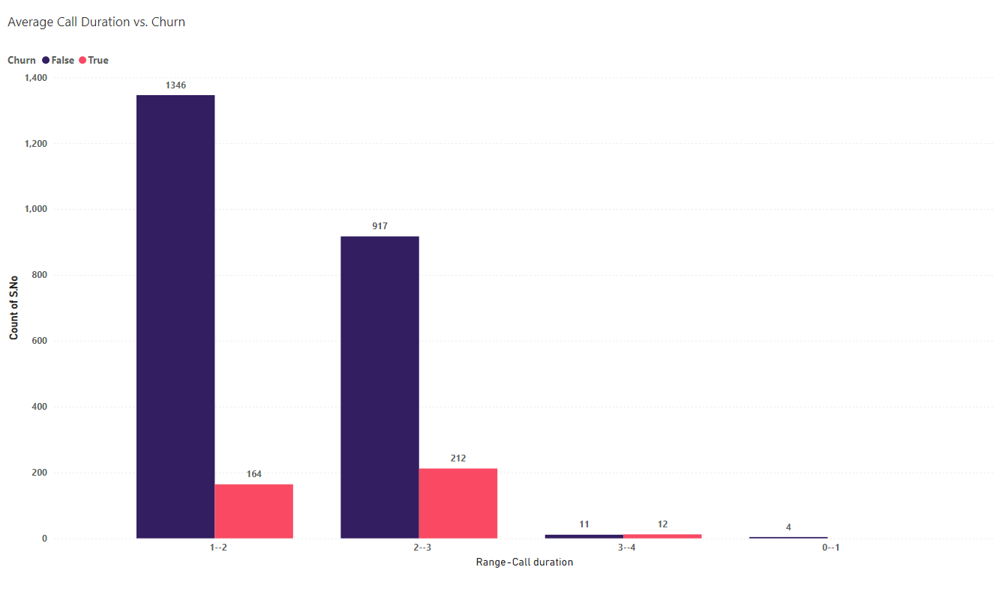

Slide 14
Average Call Duration vs. Churn
INSIGHTS
RECOMMENDATIONS
Customers with shorter average call durations tend to churn les
Churn significantly increases with longer average call duration
High churn rate for customers with 3-4 minute call duration. It might be due to Poor Call Quality & Higher costs
Attractive pricing plans for customers with higher call durations
Invest in better network infrastructure to minimize call drops
Proactively engage with customers who have shorter call durations to address potential issues

Slide 15
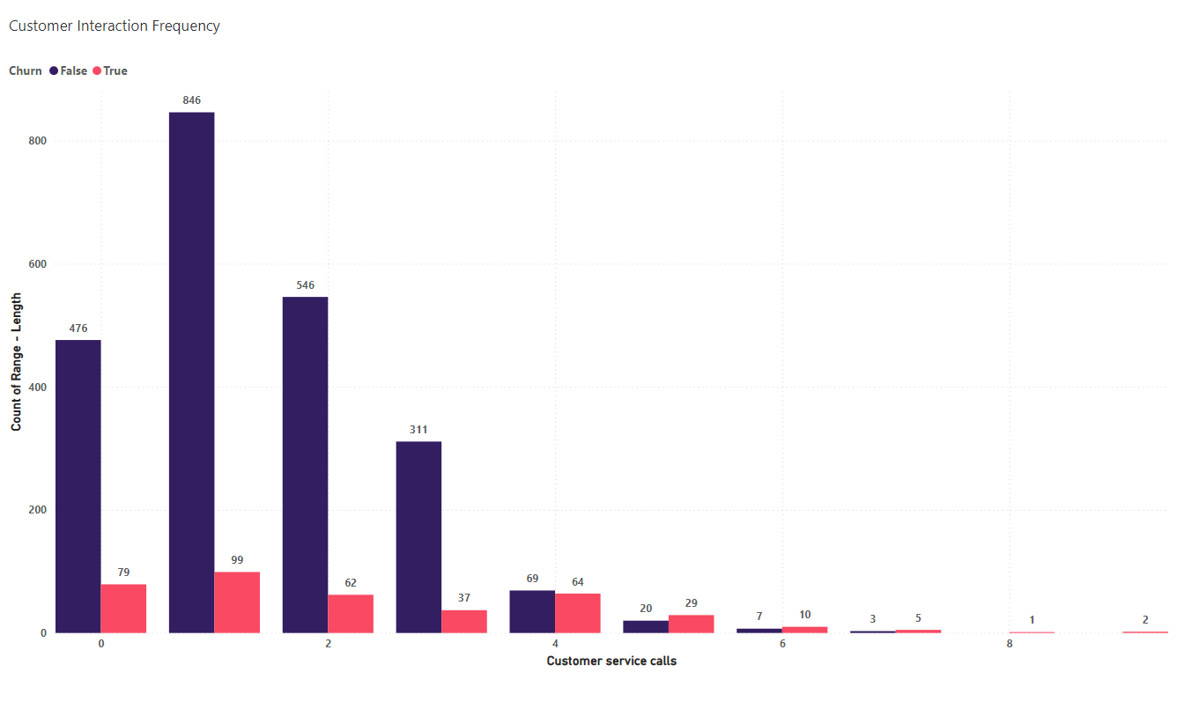

Slide 16
Customer Interaction Frequency
INSIGHTS
RECOMMENDATIONS
Customers with a higher number of customer service calls are more likely to churn
Frequent interactions may indicate unresolved problems, leading to dissatisfaction and churn
High contact frequency could be due to inadequate service
Improve training and resources for customer service reps to resolve issues effectively on first contact
Simplify and automate service processes to reduce the need for multiple interactions
Use data analytics to anticipate issues and reach out to customers before they need to call

Slide 17
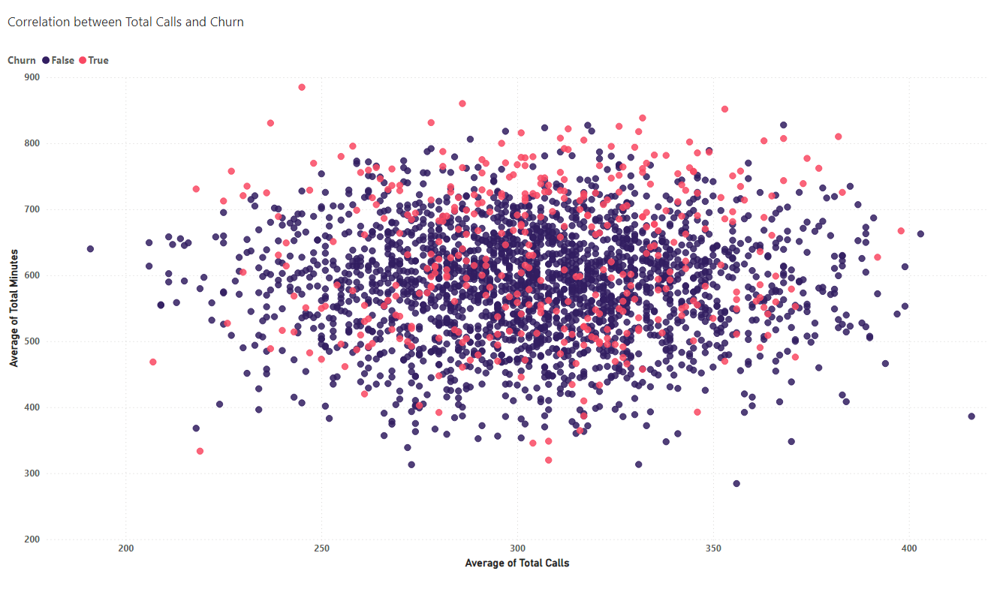

Slide 18
Correlation between Total Calls and Churn
INSIGHTS
RECOMMENDATIONS
There is a mixed proportion of customers churning, as indicated by the data
Total call duration and call frequency do not directly impact customer churn significantly
Customers may value factors other than call usage, such as network reliability, customer service quality, or cost
Focus on resolving issues effectively and improving the customer support experience
Use customer data to create personalized plans that cater to their specific needs and preferencesInvestigate reasons behind low minute usage to identify and address customer concerns

Slide 19
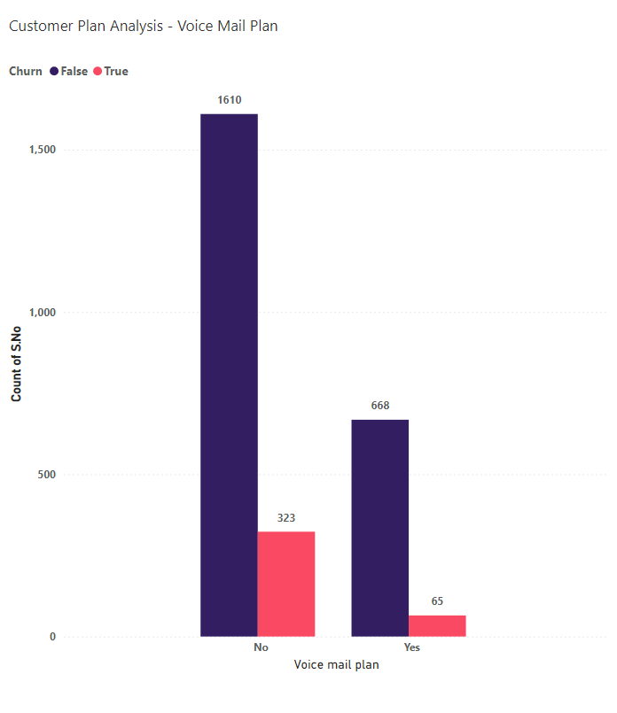

Slide 20
Customer Plan Analysis
INSIGHTS
RECOMMENDATIONS
Customers without a voicemail plan show a higher churn rate
Opting for a voicemail plan correlates with lower churn
Voicemail plans are less popular but seem effective in retaining customers
Encourage customers to adopt voicemail plans with targeted offers
Combine voicemail with other popular features to increase adoption
Highlight the convenience and benefits of voicemail to customers by strategic marketing techniques

Slide 21
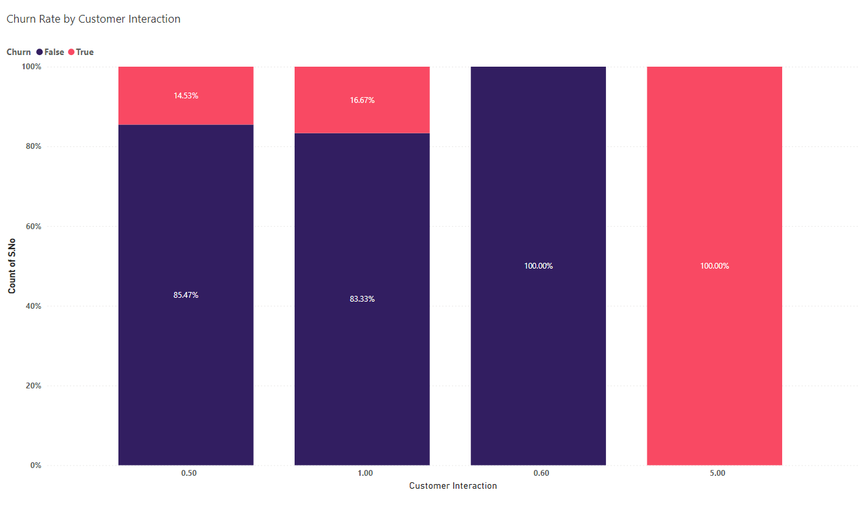

Slide 22
Churn Rate by Customer Interaction
INSIGHTS
RECOMMENDATIONS
Customers interacting with customer care more than five times have a 100% churn rate
Customers with minimal or no customer care interaction rarely churn
Frequent customer care interactions are a strong indicator of dissatisfaction
Resolve issues in the first interaction to reduce follow-ups
Track customers with multiple interactions and address their issues proactively
Implement surveys after interactions to gather feedback and improve service qualit

Slide 23
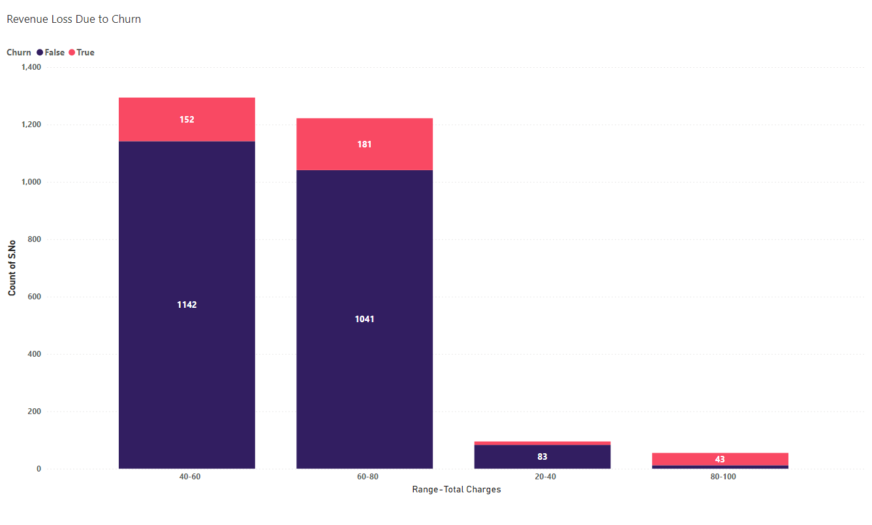

Slide 24
Revenue Loss Due to Churn
INSIGHTS
RECOMMENDATIONS
74% churn rate in the $80-$100 segment indicates significant revenue loss
$40-$60 segment has a 12% churn rate, affecting revenue considerably due to high customer volume
Churn rates increase as customer spending rises, leading to higher revenue impact
Provide special offers and loyalty programs to retain high-spending customers
Tailor plans and promotions based on customer spending patterns to enhance satisfaction
Focus on demonstrating the value provided in higher spending plans to reduce churn

Slide 25
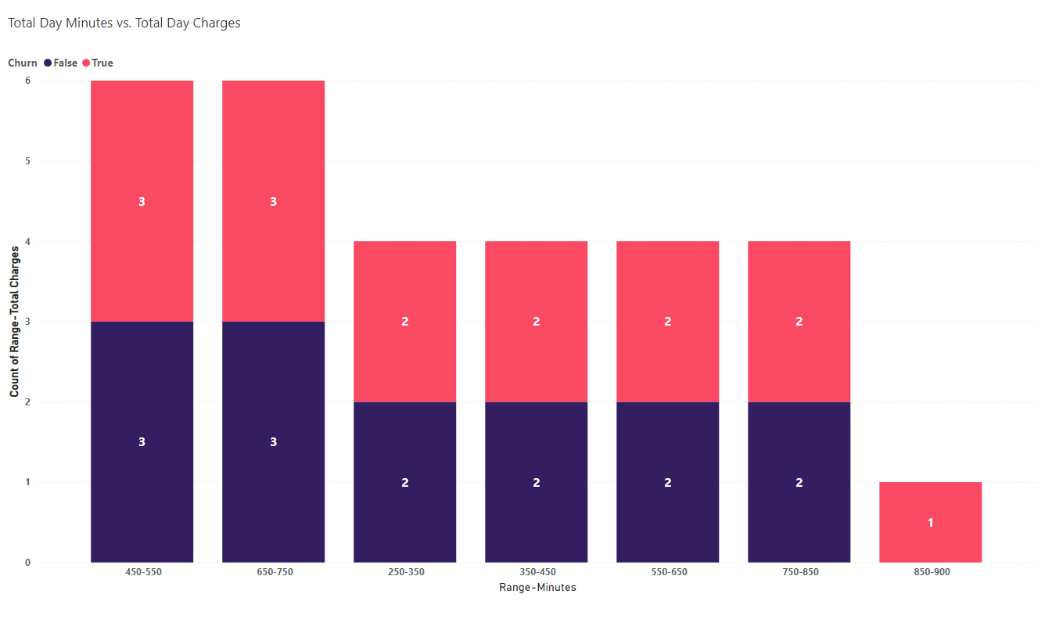

Slide 26
Total Day Minutes vs Total Day Charges
INSIGHTS
RECOMMENDATIONS
Churn is independent of total call duration across most ranges, suggesting other factors influence customer retention
Customers with extremely high call durations (850 mins) show a higher likelihood of churn
Ensure consistent service quality regardless of customer usage patterns
Regularly survey customers to understand pain points beyond call duration

Slide 27
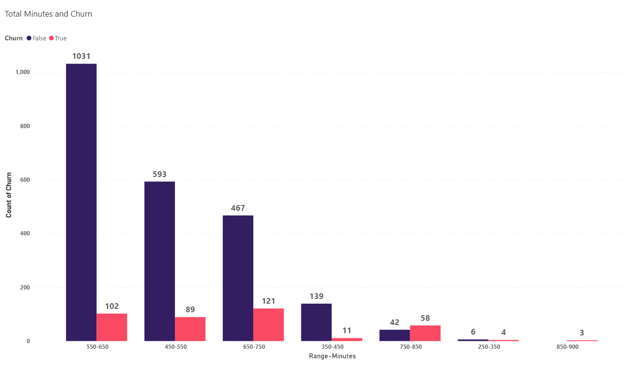

Slide 28
Total Minutes and Churn
INSIGHTS
RECOMMENDATIONS
Long call durations may indicate unresolved issues, leading to customer frustration
Increased call duration is linked to higher churn rates
Offer personalized support to customers with high call durations to enhance satisfaction
Identify and address issues for customers with high call durations proactively

Slide 29
CLASSIFICATION MODEL RESULTS

Slide 30
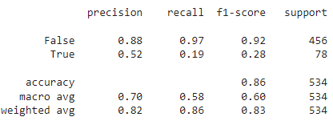
Precision, Recall and F1 score

Slide 31
Non-Churning Customers (False) Performance
Precision: 0.88 indicates that 88% of the customers predicted as not churning were actually not churning
Recall: 0.97 shows that 97% of the actual non-churning customers were correctly identified by the model
F1-Score: 0.92 is a high score, suggesting that the model is reliable in predicting non-churners

Slide 32
Churning Customers (True) Performance
Precision: 0.52 indicates that only 52% of the customers predicted as churning were actually churning, showing a high rate of false positives
Recall: 0.19 suggests that the model correctly identified only 19% of the actual churners, indicating poor sensitivity and a high number of false negatives
F1-Score: 0.28 is quite low, pointing to a need for significant improvement in predicting churners

Slide 33
Key observations
The model is accurate in predicting customers who won't churn, with a high precision of 0.88
The recall for the 'True' class (churners) is only 0.19, suggesting that the model fails to identify most of the actual churners
The Model correctly predicted 86% of the total cases. While this seems acceptable, it may not fully capture the model's effectiveness in identifying churners

Slide 34






Way Forward
Prioritize improving customer support in high-churn states and resolve issues effectively on the first contact
Implement region-specific promotions and loyalty programs to retain both new and long-term customers
Offer competitive rates and bundled services to retain price-sensitive customers and high-value users
Invest in network infrastructure to improve call quality, especially for international plan users and those with higher call durations
Utilize data analytics to anticipate customer issues and engage proactively with at-risk customers
Develop personalized plans and offer tailored support to enhance satisfaction for customers with diverse usage patterns

Slide 35

SUBMITTED BY
MOHAMED AFSAR M I
BADM - MB26
MIAFSAR@GMAIL.COM
+91 96774 76692
THANK YOU

